Slide 1
Living in the city of Eindhoven
Capstone project by Abhishek Varshney

Slide 2
Eindhoven (pop 229.637)
Currently I’m living in the neighbourhood of Prinsejagt, in the City of Eindhoven.
Unfortunately I’m forced to move, but I like to be in a similar neighbourhood.
Purpose:
Find a new neighbourhood to live in.

Slide 3
Data
We are using the following datasets for analysis:
A list of neighbourhoods in Eindhoven (link).
Name of neighbourhood (buurt), residential areas (wijken) and boroughs (stadsdeel) within Eindhoven,
their geographic coordinates,
their borders in GeoJSON format.
A table of key figures about the various neighbourhoods (link),
population, population density, area, amount of house
Foursquare

Slide 4
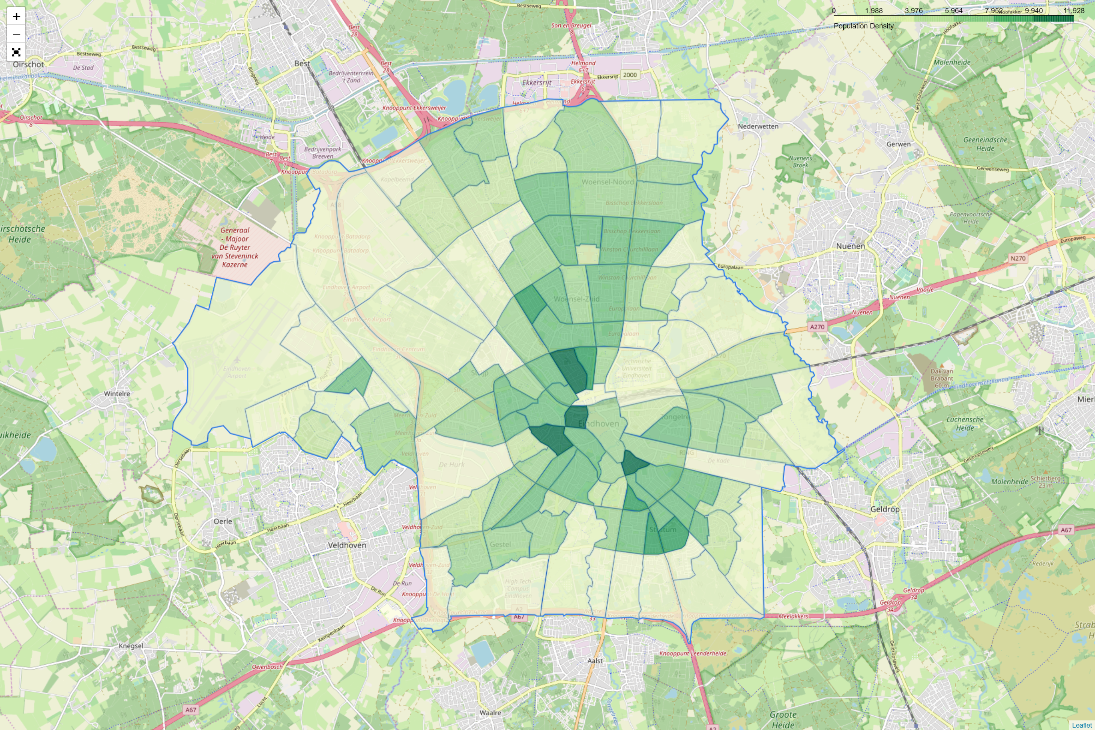
Map of Eindhoven

Slide 5
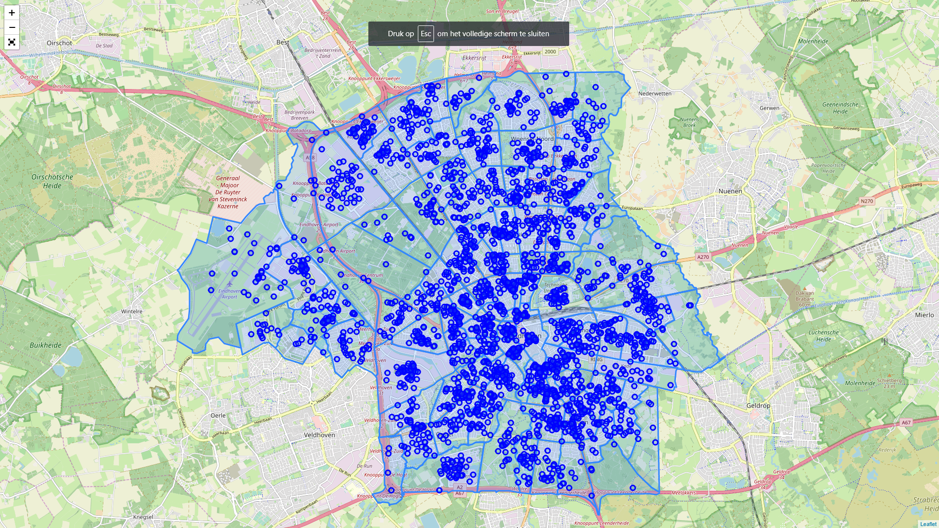
Venues on Foursquare

Slide 6
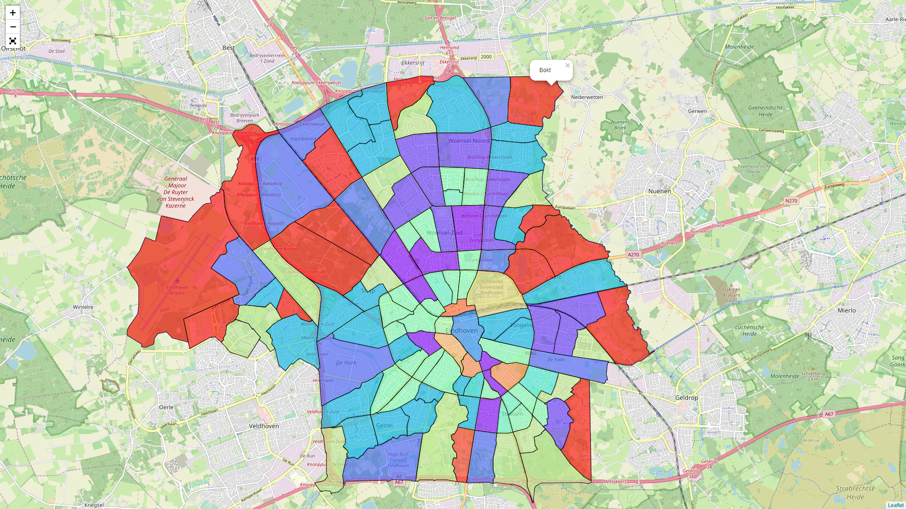
Clustering of neighbourhoods

Slide 7
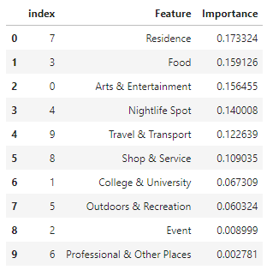
Decision tree and important features

Slide 8
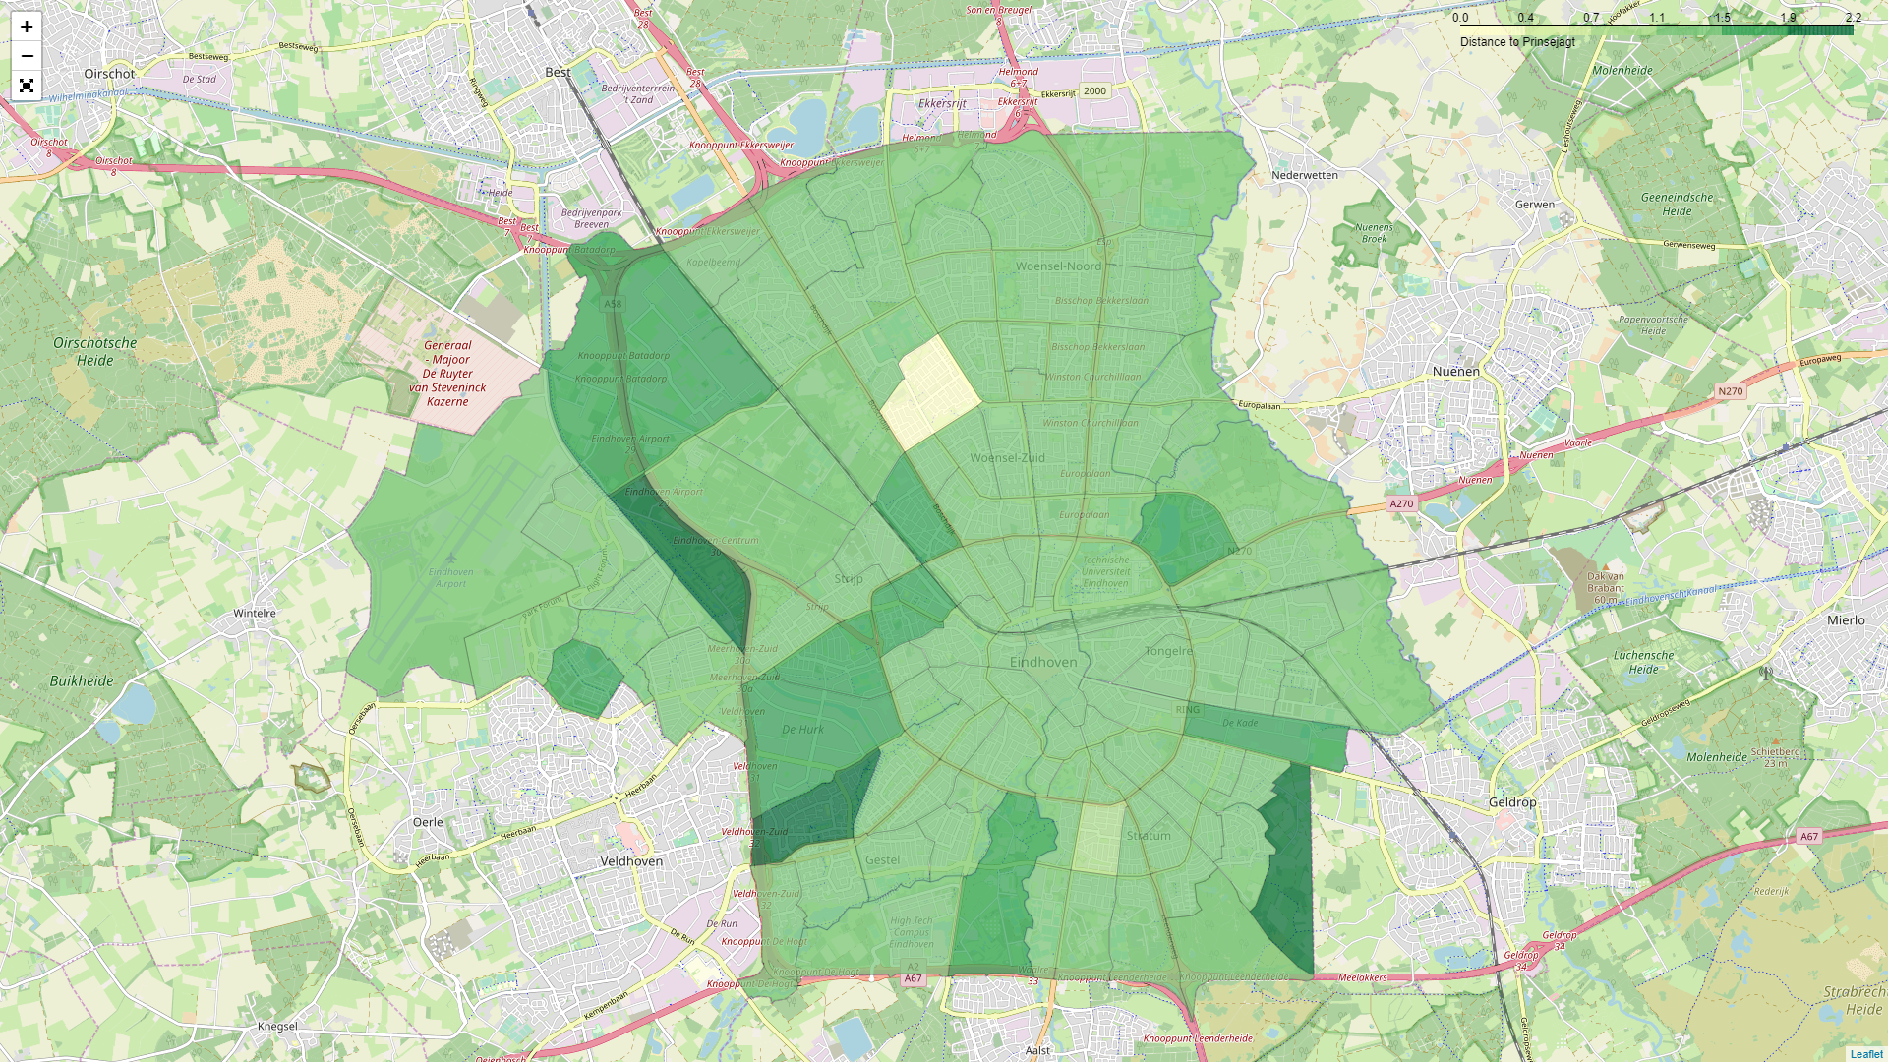
Difference from Prinsejagt

Slide 9
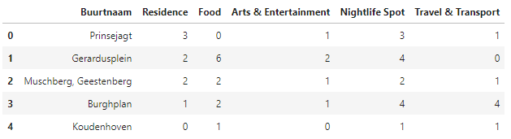
Choices

Slide 10
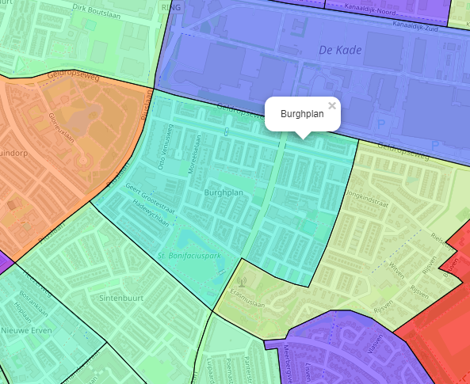
Final choice: Burghplan
Buurt Burghplan
Population 6100
Common venues:
Professional & Other places
Shop & Service
Outdoors & Recreation
Travel & Transport
Nightlife Spot

